Slide 1



ARTEMIS HACKATHON 2026
Problem Statement Title – Affordable and interactive Braille learning tools are limited, making independent education difficult for visually impaired students.
PS Category- Hardware
Team Name – TEAM CURIOSITY

Slide 2
PROBLEM STATEMENT
Describe the problem clearly:
Affordable and interactive Braille learning tools are limited while most existing devices are expensive and require supervision.
Who faces this problem?
Visually impaired students, low-income families and resource-limited special schools.
Current challenges:
High cost of assistive devices, lack of independent practice tools and dependence on trained instructors.
Real-world relevance:
Improving access to affordable and interactive Braille education promotes inclusive learning and student independence.

Slide 3
PROPOSED SOLUTION
Your Concept:
Divya Drishti is a low-cost, multi-sensory Braille learning device that combines tactile feedback and audio guidance to help visually impaired students learn independently.
How It Works (High Level):
The user selects a letter using a rotary encoder, the ESP32 controller activates specific servo motors to form the corresponding Braille pattern and the system simultaneously plays the letter’s audio through a speaker.
Main Features:
Servo-actuated Braille dots, synchronized audio feedback, compact design and affordable cost under ₹5,000.

Slide 4
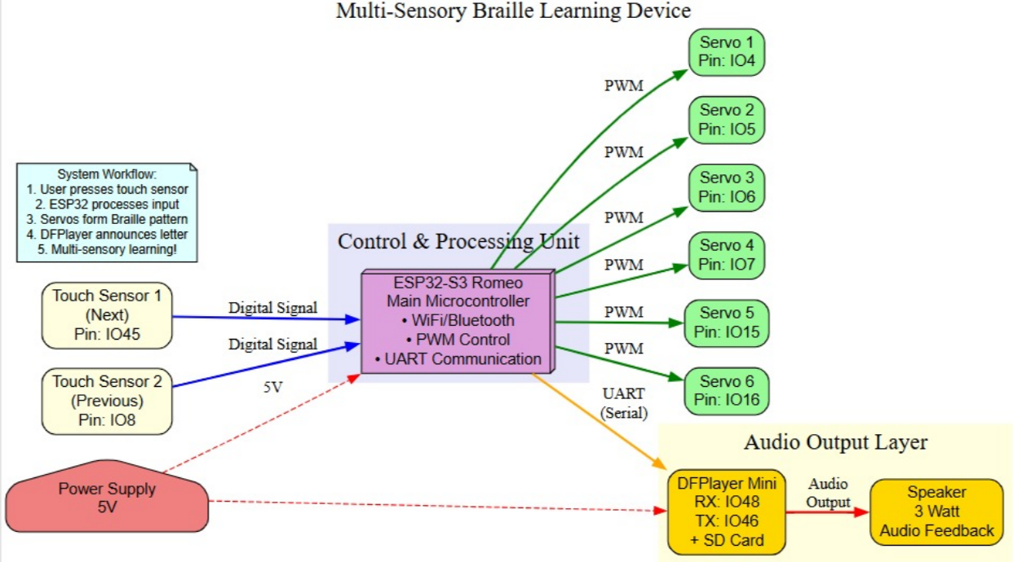
TECHNICAL APPROACH

Slide 5
FEASIBILITY AND VIABILITY
Analysis of the Feasibility of the Idea:
The project uses low-cost, easily available components like ESP32 and servo motors, making it technically feasible and affordable to manufacture.
Potential Challenges and Risks:
Mechanical wear of servo motors, durability of moving Braille pins, limited scalability and ensuring accurate tactile feedback.
Strategies for Overcoming These Challenges:
Use high-quality servos, durable pin materials, modular design for easy maintenance, thorough testing and future integration of wireless updates for scalability.

Slide 6
CHALLENGES AND RISKS
Mechanical failure of servo motors over time
Wear and tear of moving Braille pins.
Power consumption and battery limitations.
Need for regular maintenance of the moving parts and actuators .

Slide 7
IMPACT AND BENEFITS
Potential Impact on the Target Audience:
Improves independent Braille learning, boosts confidence among visually impaired students and increases access to affordable assistive education tools.
Benefits of the Solution:
Social — Promotes inclusive education and equal learning opportunities.
Economic — Affordable compared to existing commercial devices, reducing financial burden on families and schools.
Educational — Enables self-paced, interactive learning.
Environmental — Low power consumption and compact design reduce material and energy usage.

Slide 8
TARGET USERS
Blind primary school students learning basic Braille alphabets
Visually impaired students in special education schools
Students in rural areas with limited access to assistive technology
Children from low-income families who can’t afford expensive Braille devices
Newly visually impaired learners starting Braille education
NGOs and rehabilitation centers training blind students

Slide 9
FUTURE SCOPE
Integration with mobile app for progress tracking
Addition of advanced Braille (words, sentences, contractions)
Multi-language audio support
AI-based adaptive learning modes
Cloud data storage for teacher monitoring (future upgrade)
Integration with school inclusive education programs

Slide 10
BUSINESS MODEL / PROFIT STRATEGY
Business Model:
Direct sales to schools, special education centers, NGOs and individual families.
Partnerships with government inclusive education programs.
Bulk supply to rehabilitation institutes.
Profit Strategy:
Low production cost with reasonable margin per unit.
Bulk order discounts with volume-based profit.
After-sales service and maintenance packages.
Future revenue through software/app upgrades and premium learning modules.

Slide 11
RESEARCH AND REFERENCES
Details of the reference and research work
Springer / Academic Research Related to Braille Systems. Electronic Device for Learning Braille Reading/Writing System (Springer) – Describes an electronic Braille learning prototype using open-source hardware with raised tactile points recognizable by touch, supporting autonomous learning .
Refreshable Braille Display using Solenoids and Microcontroller – A prototype for a refreshable Braille display using solenoid actuators and Arduino-based control, offering context on alternative actuator solutions.
Low-Cost Refreshable Braille Display Design & Development – Presents a system using electromagnetic actuators and microcontroller control, focused on cost reduction in tactile interfaces.

